Slide 1




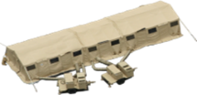


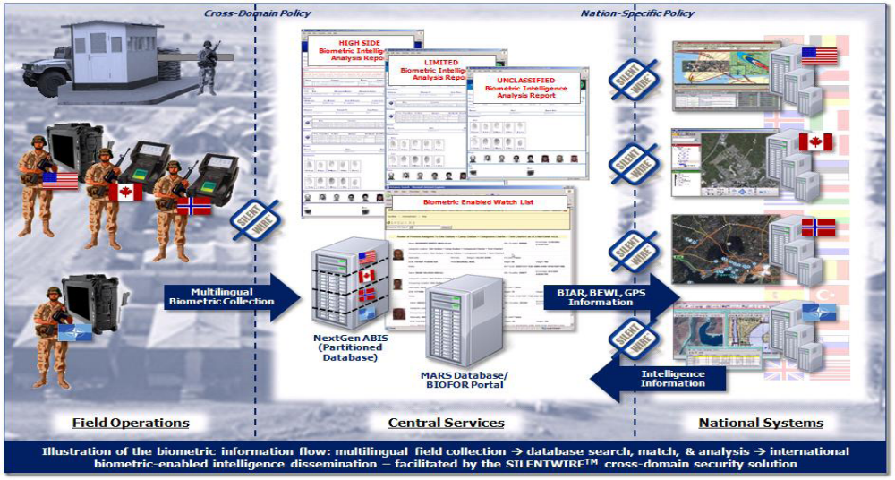
UNCLASSIFIED
Standardizing Coalition C2 Access, Data, and Services (SCC2ADS)
Operational Challenge: IOA 4
  Technology Description / Product:
  SCC2ADS produces software that automates secure access to COP information in a mission network. Using a Pub/Sub web service, partners will share and control access between command post C2 nodes
  Competing Approaches: Request/response (inefficient); enterprise (costly).
  Starting TRLs: 4-6 Ending TRLs: 7-8
C2 COP information shared using access controlled pub-sub service
US Army (CP CE)
USMC (TSOA)
NATO (NCOP)
Key Deliverables:
  Web service software for CP CE and TSOA programs
  CONOPS, TTP, and configuration guidance
  Guidance for FMN Implementation Plan and MPE JMEI
  Message schemas/artifacts posted to US repository for reuse
Make Common Operational Picture (COP) data more reliable, secure, and interoperable in support of Joint and Coalition operations.
Key Partners / Participants:
CCMD Sponsor(s): USEUCOM
Technical Manager: Mr. Carl Busart (PEO C3T)
Operational Manager: Mr. Mike McGuinness (USEUCOM)
Transition Manager: Mr. Thomas Gwiazdowski (TSOA)
Other Participants: USMC PMM-111, Joint Staff J6; NATO Allied Command Transformation
  Transition Strategy: Software to be transitioned via US Army CP CE program and USMC TSOA program. Both programs offices are active partners in the JCTD and have funds for transition.
Funding:
Cost Share-Cash ($M) | FY18 | FY19 | FY20 | Total
EC&P / JCTD Funds | 1.961 | 2.087 | 2.252 | 6.300
US Army PM MC | 0.349 | 0.349 | 0.349 | 1.047
USMC PMM-111 | 0.260 | 0.260 | 0.260 | 0.780
Joint Staff J6 | 0.313 | 0.375 | 0.375 | 1.063
NATO ACT | 0.500 | 0.500 | 0.500 | 1.500
  Expected Operational Value:
  Operational agility: Improved ability to access, control, share, and manage COP data within Joint, Coalition, and other Mission Partner environments.
  Increased situational awareness: Tailored information sharing enabled by leading edge technologies in web services, identity and access management, and data tagging
CNCR ($M) | FY18 | FY19 | FY20 | Total
US Army PM MC | 0.814 | 0.814 | 0.815 | 2.443
USMC PMM-111 | 0.860 | 0.860 | 0.860 | 2.580
Joint Staff J6 | 0.250 | 0.250 | 0.250 | 0.750
NATO ACT | 1.000 | 1.000 | 1.000 | 3.000
Revision Date: 07/11/2017
UNCLASSIFIED
Notes:
CCMD Sponsor(s): USEUCOM; Mr James Wiltz; James.r.wiltz.civ@mail.mil; DSN: 314-430-8922
Technical Manager: US Army PEO C3T; Mr. Carl Busart; carl.e.busart.civ@mail.mil; (443) 395-2211
Operational Manager: USEUCOM; Mr. Mike McGuinness; michael.t.mcguinness.civ@mail.mil; DSN: 314-430-7059
Transition Manager: SSC-LANT; Mr. Thomas Gwiazdowski; thomas.gwiazdowski@navy.mil; (843) 276-6730
Joint Staff J6; Mr. Steve Litwiller; steven.w.litwiller.civ@mail.mil; (757) 836-8072
Allied Command Transformation; Mr. Terry McCoy; terry.mccoy@act.nato.int; (757) 747-3492

Slide 2

Back-ups
Notes:
07/27/17

Slide 3

Standardizing Coalition Command & Control Access, Data, and Services (SCC2ADS)
Fiscal Year 2018-20
Oversight Executive: Mr. Rudy Gainer
CCMD Sponsor(s): USEUCOM
Operational Manager: USEUCOM / JS/J6: Mike McGuinness / Steve Litwiller
Technical Manager: USA PM MC: Mr. Carl Busart
Transition Manager: SSC-LANT: Mr. Thomas Gwiazdowski
Other partners: USMC PMM-111: Maj Austin Bonner; NATO Allied Command Transformation: Mr. Terry McCoy
Notes:
Note: NATO is a committed SCC2ADS partner, but is self-funded
07/27/17

Slide 4
SCC2ADS
Operational Problem Statement
Primary Focus Area: Information Operations and Analytics
Primary Operational Challenge: IOA 4 – Increase ISR data processing, exploitation and dissemination and data sharing with Coalition/Partner Nations.
Current Threat:
Ability to share and secure information between US C2 systems and coalition partners is cumbersome and inefficient.
Federation and security of publish-subscribe services are immature for joint and coalition operations.
Ability to perform Identity and Access Management (IdAM) functions of verification, authentication and authorizations in the coalition networking environment are not automated and require intensive implementation efforts.
Multiple data standards / formats creates interoperability challenges in coalition environments.
Lack of web services situational awareness diminishes warfighter confidence in C2 system.
Addresses CCMD IPLs (FY19-23): EUCOM 11; EUCOM 40; EUCOM 41, AFRICOM 5, CENTCOM 21, NORTHCOM 10, PACOM 54, SOCOM 10

Slide 5

SCC2ADS
What is it? This project will make Common Operational Picture (COP) data more reliable, secure, and interoperable in support of Joint and Coalition operations.
What will project do? Build prototype software solutions that implement secure information exchanges between coalition partners using:
Publish-subscribe services;
Automated access controls based on user credentials;
Automated machine-to-machine standardized data exchanges;
Automated web services management features (e.g., alerts, status monitoring of pub-sub services).
Operational value to the warfighter:
Operational agility: Improved ability to access, control, share and manage data between Coalition C2 systems.

Slide 6
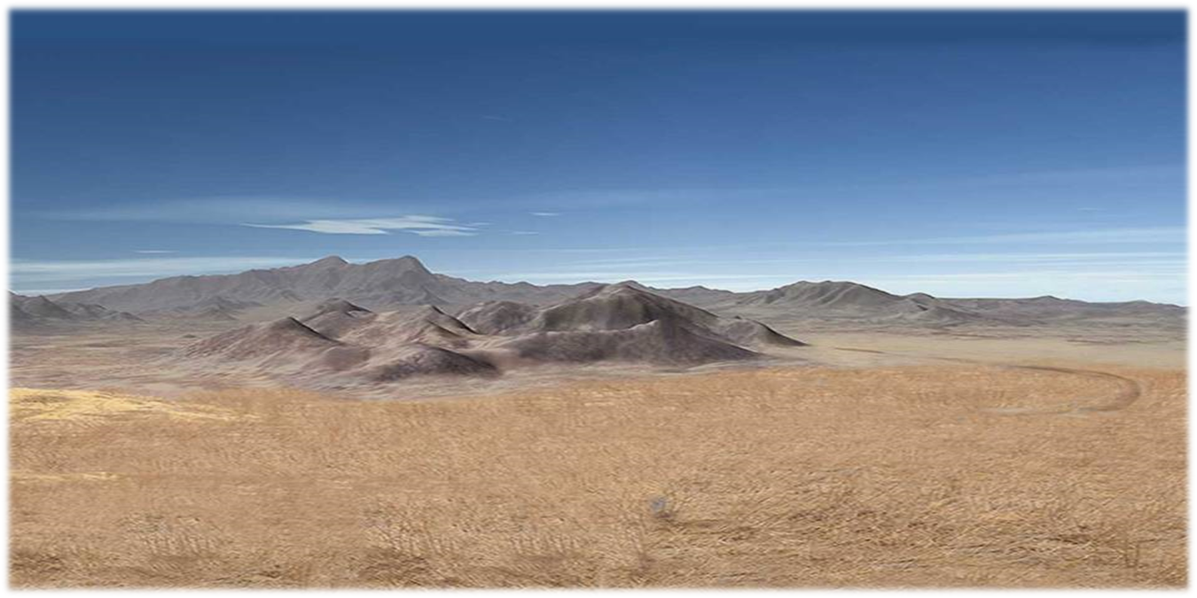

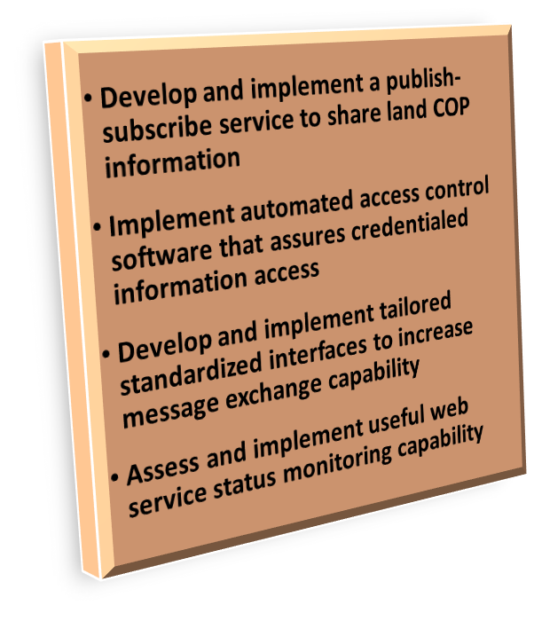





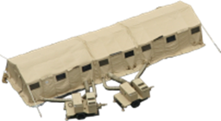






Implementing automated access control and message exchanges in the coalition networking environment
INTEROPERABILITY
RELIABILITY
Use automated standardized message interfaces
Produce CONOPs, TTPs, and web service status features
Develop personal attributes, authentication certificates, and metadata labels
“I”
“R”
“S”

Slide 7
SCC2ADS Objectives
Develop and implement secure publish-subscribe web services for sharing C4 and ISR COP information.
Develop and implement automated access control for shared information.
  Identify optimum coalition access controls.
  Develop service monitoring / status capability.
Demonstrate improved COP information interoperability using data standardization.
  Uniform interfaces (JC2 RA 3.1 e.g. NIEM, JSON)
I
S
S
R
I

Slide 8
SCC2ADS Technologies
Key Technologies:
Primary technical challenge(s) and approach to overcome and/or potential alternatives:
Integration and configuration of software solutions with multiple partner systems developed independently using different software development platforms is the primary challenge. Experience shows that existence of common standards is insufficient to assure automated, effective information exchanges, and operational compatibility requires development, testing, and implementation run-throughs (i.e. develop and implement TTP). This formative IT requirement does not have realistic, potential alternatives.
Competing Technologies and Efforts:
None.
Technology (Army / USMC) | Pre-JCTD | Post-JCTD
Services and Software | (Army / USMC) | (Army / USMC)
Data mediation software | 4 / 6 | 7 / 8
Publish-Subscribe services software | 5 / 6 | 7 / 7
Metadata labeling software compliant with US and NATO standards | 4 / 4 | 7 / 7
Service Management and Control Software | 4 / 4 | 6 / 7
Communications and Networking
Access control software compliant with NATO STANAG standards | 4 / 4 | 7 / 7
I
S
S
R
S
Notes:
Recommend PM MC and TSOA SMEs be on hand to address questions about TRL levels.
For the Army, current software exists that perform all of these functions, but none of them is mature, and none have been tailored to Joint and Coalition environments. Additionally changes are required to comply with latest standards and guidance, and new capabilities will be added as part of this project. For example, pub-sub software exists, but not that has integrated with an interoperable IdAM solution. SMC software exists, but not that provides alerts/warning to end users. And CPCE is integrating a new data mediation layer into the CPCE architecture based on Sitaware.
For the USMC, current software exists that perform all of these functions (except for the metadata labeling and access control), but none of them is mature, and none have been tailored to Joint and Coalition environments. Additionally changes are required to comply with latest standards and guidance, and new capabilities will be added as part of this project. For example, data mediation software exists, but a NIEM-conformant capability will be added as part of this project. For example, pub-sub software exists, but not that has integrated with an interoperable IdAM solution. SMC software exists, but not that provides alerts/warning to end users.
TS3 for US Army (PM MC)
US Army data mediation will use new OSGi (Open Service Gateway Initiative) bundles in MUSTANG
For pub-sub, Army will use DDS/C2IUL
For SMC, Army will use WIN-T/NEST/Cuber SU (situational understanding)/DCO I)
- DCOI: defensive cyberspace operations infrastructure
For access control, Army will use Tactical PKI from WIN-T

Slide 9
SCC2ADS Activities / Deliverables
YEAR 1: Implementation Documentation (Implementation Directive, Management Plan, WBS, Test Plan / Report generation), TD-1, Assessments, IMT Meetings / Reviews, Table-top integration and planning, TD Plan and TD venue coordination.
  SPECIFIC ACTIVITIES/DELIVERABLES INCLUDE:
      Modify and develop software that executes the Pub-Sub service between partners (partners will be at different maturity levels)
      Define / modify / develop message exchange data standards (IEPDs) and related business rules
      Define business rules for data tagging
      Develop basic design plan for TD and OD
      Develop / deliver Implementation Plan and CONOPS
      Conduct Technical Demonstration
      Mediate IdAM methodologies to enable security of publish-subscribe services
      Develop project metrics
  YEAR 2: Update Documentation (Management Plan, WBS, Test Plan / Report generation), IMT Meetings / Reviews, Table-top integration and planning, TD Planning and execution, OD Plan and venue coordination.
  SPECIFIC ACTIVITIES/DELIVERABLES INCLUDE:
      Refine software solutions developed in year 1
      Integrate and demonstrate automated IdAM solutions with publish-subscribe services
      Develop data tagging software to enable access control
      Develop Service Management and Control features on the publish-subscribe services
      Assess / integrate project software solutions with FMN Spiral 2
      Integrate project solutions to CPCE, TSOA, NCOP, PEGASUS
      Refine metrics
      Conduct Technical Demonstration(s) / Operational Demonstration
      Initial development of Transition Plan / Technology Transition Agreements
Notes:
Year 1
- Modify and develop software that will execute the Pub-Sub service between partners (partners will be at different maturity levels)
- Define / modify / develop message exchange data standards (IEPDs) and related business rules
- Define business rules for data tagging
- Develop basic design plan for TD and OD
- Develop draft CONOPS
- Conduct a basic NIEM exchange (TD)

Slide 10
SCC2ADS Activities / Deliverables
YEAR 3: Update Documentation (Management Plan, WBS, Live Demonstration Plan / Report generation), IMT Meetings / Reviews, Table-top integration and planning, TD Planning and execution, OD/LD Plan and execution.
ACTIVITIES / DELIVERABLES INCLUDE:
    Integrate project solutions to CPCE, TSOA, NCOP, PEGASUS
    Implement software and procedures that support shared service management and control capabilities
    Produce updates for FMN guidance on IdAM, publish-subscribe services, and SMC
    Demonstrate data tagging software
    Generate final Joint / Coalition, cross-functional XML-based data exchanges (NIEM IEPDs) for incorporation into MPE
    Incorporate NIEM IEPDs into the NIEM Military Operations Domain library and NATO
    Author software developer documentation
    Conduct TD and OUA and deliver assessment reports
    Deliver Letter of Military Utility
    Deliver signed Technology Transition Agreements
    Deliver automated IdAM and data format mediation software to US Army, USMC and NATO ACT
    Final report

Slide 11
SCC2ADS Demonstration Plan
  FY 18
Objectives: Demonstrate pub-sub services, IdAM, and Service Management and Control information sharing within an MPE / FMN Framework.
3Q FY18: Technical Demonstration at Program Office labs.
4Q FY18: Limited Operational Demonstration at CWIX 18.
Participants: USA CPCE/OPSpace, USMC TSOA, NATO/NCOP, other NATO nations
  FY 19-20
Objectives: Demonstrate pub-sub services, IdAM, and Service Management and Control information sharing within an MPE / FMN Framework.
2Q FY19: Technical Demonstration using CV2E network.
4Q FY19: Operational Demonstration at Trident Juncture / Steadfast Cobalt / Unified Vision / EUCOM venue.
Participants: USA CPCE/OPSpace, USMC TSOA, NATO NCOP, other NATO nations
Leveraging NATO or EUCOM-sponsored venues facilitates participation by other NATO nations and organizations.

Slide 12
SCC2ADS Transition Strategy
What will be transitioned?
Access control, information exchange services, and data exchange software and tools.
    Improved US Army and USMC C2 system software that aligns with NATO standards.
    Pub-sub services standards for the MPE / FMN.
    NIEM Information Exchange Specifications (IES)
Where will it be transitioned?
Into the Programs of Record of each participating Partner.
  PoRs include: USMC (TSOA); USA (CPCE); ACT/NCIA (NCOP)
Into the NIEM framework. Software deliverables are added to the Military Operation Domain and the NIEM Core repositories for access and reuse by other DOD, interagency, or multinational operators.
Into FMN and MPE architectures. Configuration and TTP will be added to FMN Specifications and MPE JMEIs.
Who will be responsible for making it happen? When will transition occur?
PoRs – Program manager in each participating program has committed to incorporating software into their C2 system. Transition will occur during the execution of the project within the systems being used by project partners, as coordinated by the Transition Manager.
NIEM – Military Operations Domain steward agreed to incorporate the software deliverables into the Domain and Core repositories.
What are expected costs of transition and funding sources?
$320K in the project. Majority of transition cost is borne by the implementing PoR.
Notes:
JMEIs: Joining, Membership, and Exiting Instructions

Slide 13
SCC2ADS
Funding
Partner Cost Share ($M) | FY18 | FY19 | FY20 | Total
Army PM MC | $1.160 | $1.160 | $1.170 | $3.490
USMC TSOA (PMM-111) | $1.120 | $1.120 | $1.120 | $3.360
USMC MCWL
NATO ACT | $1.500 | $1.500 | $1.500 | $4.500
Joint Staff J6 | $0.563 | $0.625 | $0.625 | $1.813
Total ($M)
JCTD Program Funds ($M) | FY18 | FY19 | FY20 | Total
Army PM (TM) | $1.066 | $1.067 | $1.067 | $3.200
USMC TSOA (XM) (PMM-111) | $0.260 | $0.260 | $0.260 | $0.780
Joint Staff J6 (IA) | $0.290 | $0.290 | $0.290 | $0.870
Independent Assessor | $0.145 | $0.270 | $0.435 | $0.850
USEUCOM (OM) | $0.200 | $0.200 | $0.200 | $0.600
NATO ACT | $0 | $0 | $0 | $0
Total ($M) | $1.961 | $2.087 | $2.252 | $6.300
*CNCR: $XX.XXM (See notes for additional details)
Notes:
07/27/17
The top table reflects the amount of resources your existing programs agreed to dedicate to the SCC2ADS JCTD.
The bottom table reflects your request for additional JCTD funds.
Given your share of the total from these two tables, please populate the next slide with your estimates of how those resources will be allocated.

Slide 14
SCC2ADS Partnerships, Status
Partners | Status | Impact (Funding & Operational)
European Command (EUCOM) | On board | Operational Manager and Sponsor
US Army PM Mission Command, Command Post Computing Environment (CPCE) Program | On board | Technical Manager, Development and prototyping partner.
US Army Europe (USAREUR) | In discussion | Prototyping partner
USMC Tactical Service Oriented Architecture (TSOA) Program | On board | Transition Manger, Development and prototyping partner.
NATO Allied Command Transformation, NATO Common Operating Picture (NCOP) | On board | Development and prototyping partner.
Joint Staff J6 | On board | Deputy Operational Manager
OSD CIO | In discussion | Observer/Advocate
Combined Communications Electronics Board (FVEY) (Pegasus) | On board | Observer
Notes:
Networked-Interoperable-Real-time-Information-Services
07/27/17

